Slide 1
Final Cooling with Thick Wedges for a Muon Collider
Daniel Fu
Diktys Stratakis, David Neuffer

Slide 2
What is a Muon Collider?
Proposed particle accelerator colliding muons and antimuons
Current particle accelerators use protons or electrons
Electrons lose energy to radiation – harder to reach high energy
Protons are composite particles – collisions, more complex, less efficient
Muons are high mass, elementary particles – best of both worlds
Potential to reach BSM physics with smaller footprint
Comparison of muC footprint v.s. other proposals
Maybe a diagram of MuC at Fermilab

Slide 3
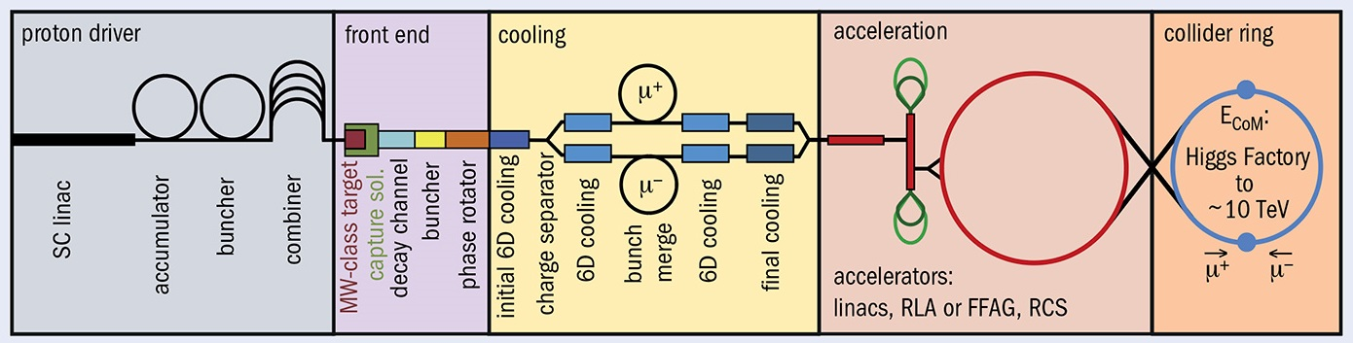
Emittance and Cooling
Anthony’s formula explaining how emittance affects luminosity
Muons are unstable, must be produced from proton-target collisions
Initially high variance in position and momentum – measured by emittance (longitudinal and transverse)
Reducing emittance is important for maximizing luminosity; this process is known as cooling
Example of a phase-space plot

Slide 4
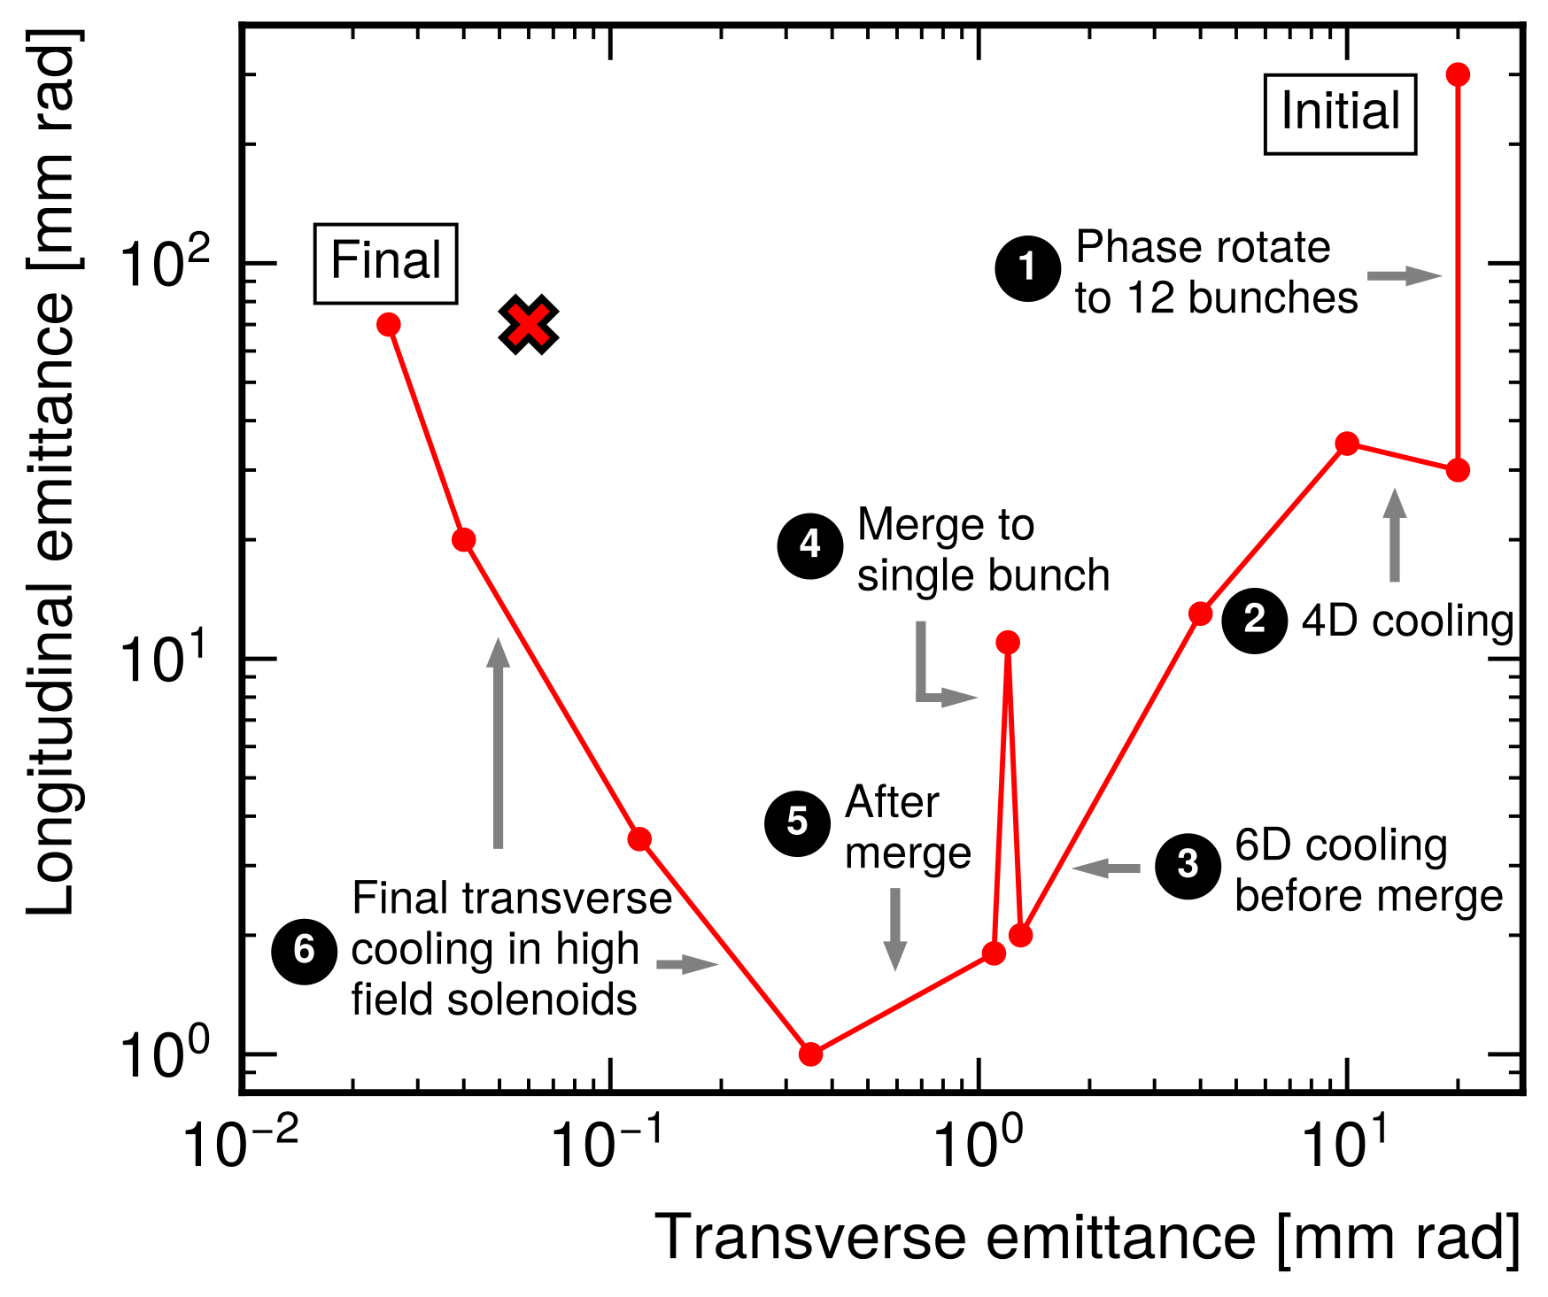
Final Cooling
Cooling occurs in several stages
Methods limited by muon lifetime
Final cooling reduces transverse emittance, longitudinal emittance can be allowed to grow
Target emittance around 30 μm transverse, 100 mm longitudinal

Slide 5
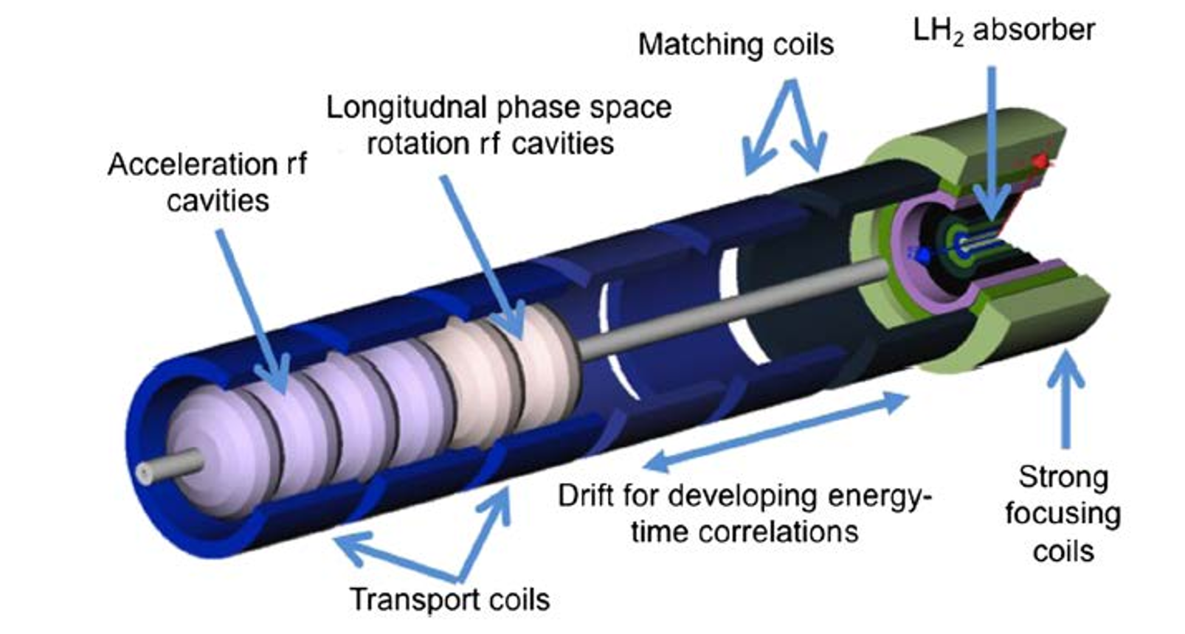
Baseline: Ionization Cooling
Beam passed through matter, loses energy through ionization
Momentum reduced in all axes (transverse and longitudinal)
Beam is then reaccelerated with RF cavity, increasing longitudinal momentum
Ends with greater proportion of momentum in longitudinal direction = cooling achieved
Diagram of the ionization cooling process on a particle level

Slide 6
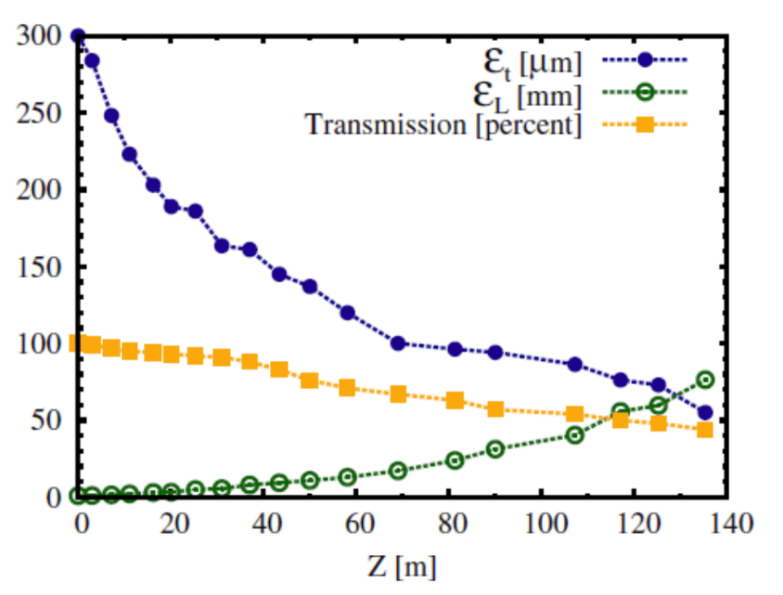
Baseline: Ionization Cooling
(Is this plot needed? It doesn’t quite fit on the previous slide but I could cram it in)
Source: 1612.08960

Slide 7
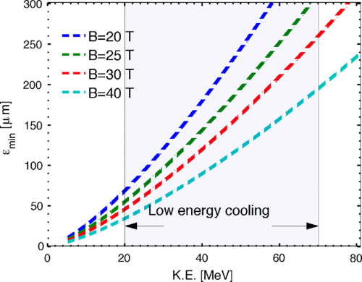
Problems with Baseline Final Cooling
Multiple scattering limits emittance reduction – equilibrium point dependent on momentum and beam width (beta)
High field solenoids required (40-50 T) – impractical to construct and operate
Low momentum required – drastically increases longitudinal emittance
Formula showing ionization cooling equilibrium point v.s. momentum and beta, and/or formula relating beta to field strength

